Slide 1
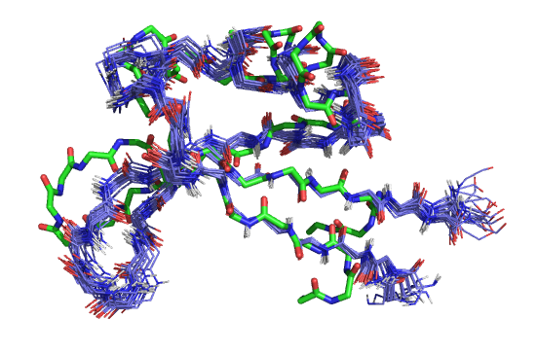
Conformational
ENTROPY
Sannali M Dittli
14 October 2015

Slide 2
What is “entropy”?
Macrostates and microstates: what is the “seating chart entropy” of this class?
How does a protein fold into the correct structure?
Conformational analysis of organic molecules
Conformational entropy of proteins

Slide 3
What is
ENTROPY?

Slide 4
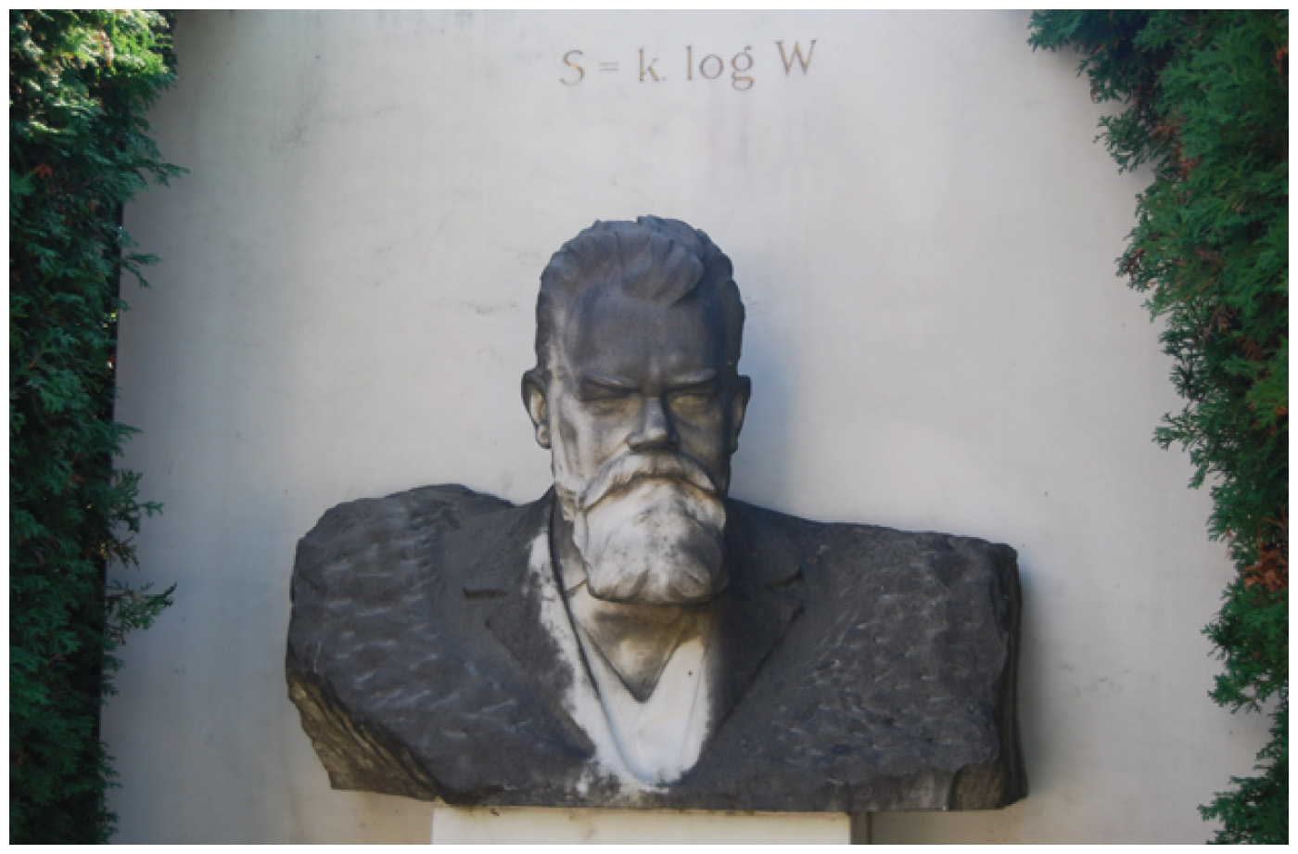
Entropy is a function of the number of energetically equivalent ways to achieve a particular set of conditions

Slide 5
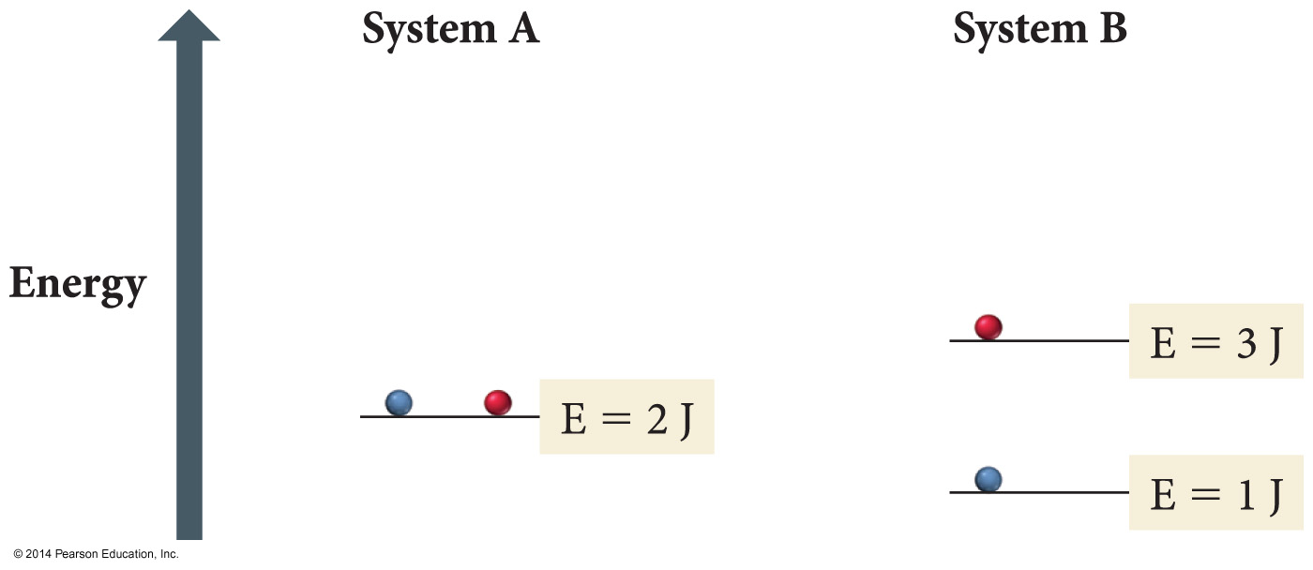
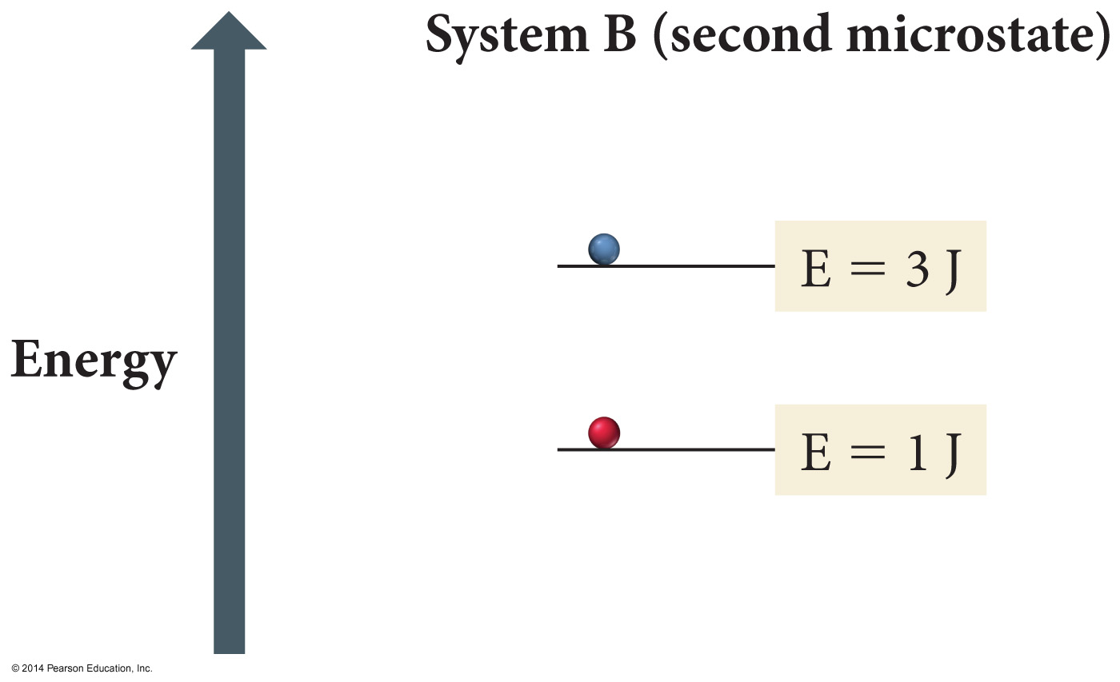
System B has greater entropy than system A because it has more ways to achieve the same result (4 J total energy)
Images from “Chemistry: A Molecular Approach”, Tro, 3rd ed

Slide 6
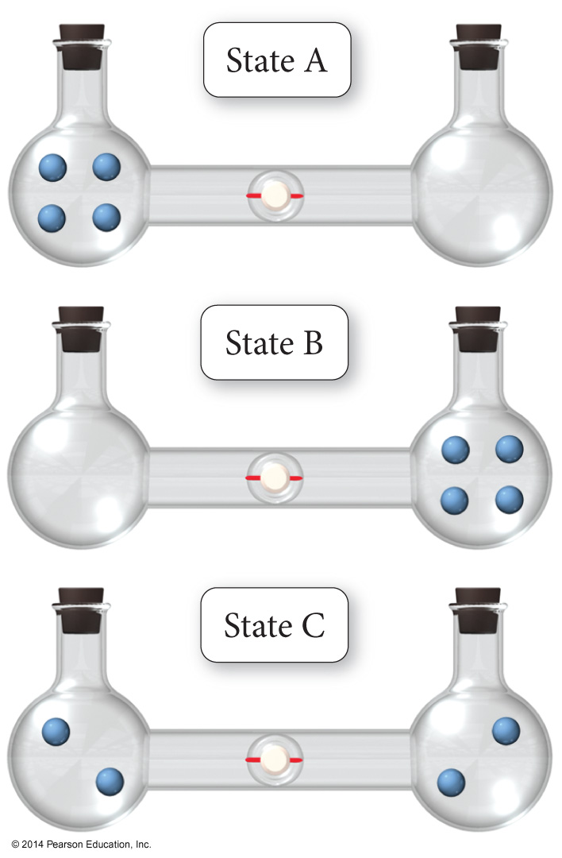
Each of these conditions represents a macrostate
If we label the atoms, how many arrangements, or microstates, can we make that result in each macrostate?
Images from “Chemistry: A Molecular Approach”, Tro, 3rd ed

Slide 7
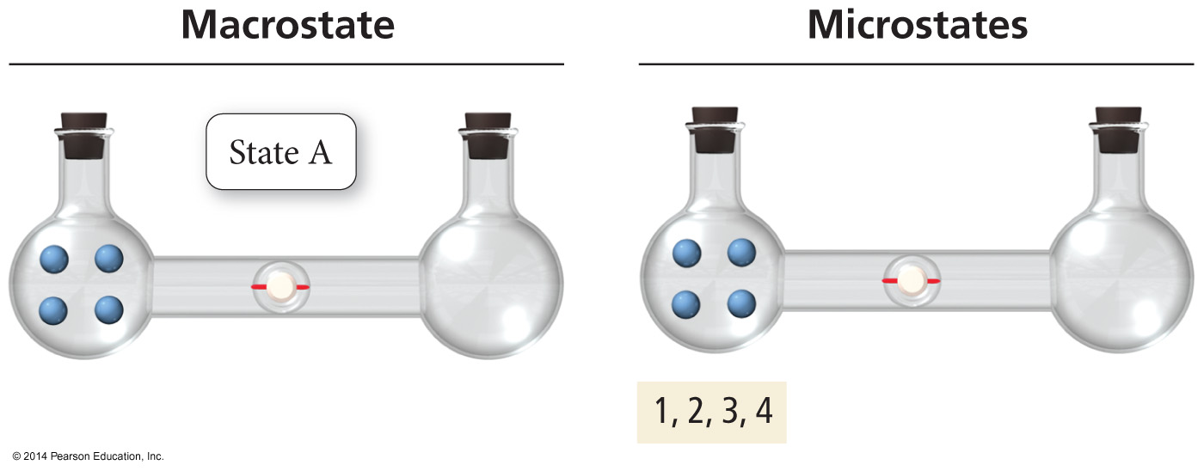
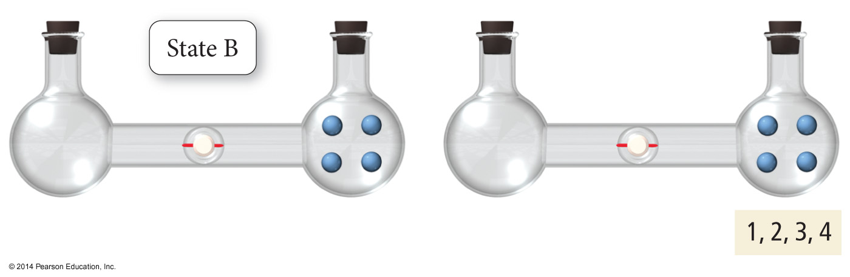
There is only one microstate way to make macrostate A, and there is only one microstate way to make macrostate B
Images from “Chemistry: A Molecular Approach”, Tro, 3rd ed

Slide 8
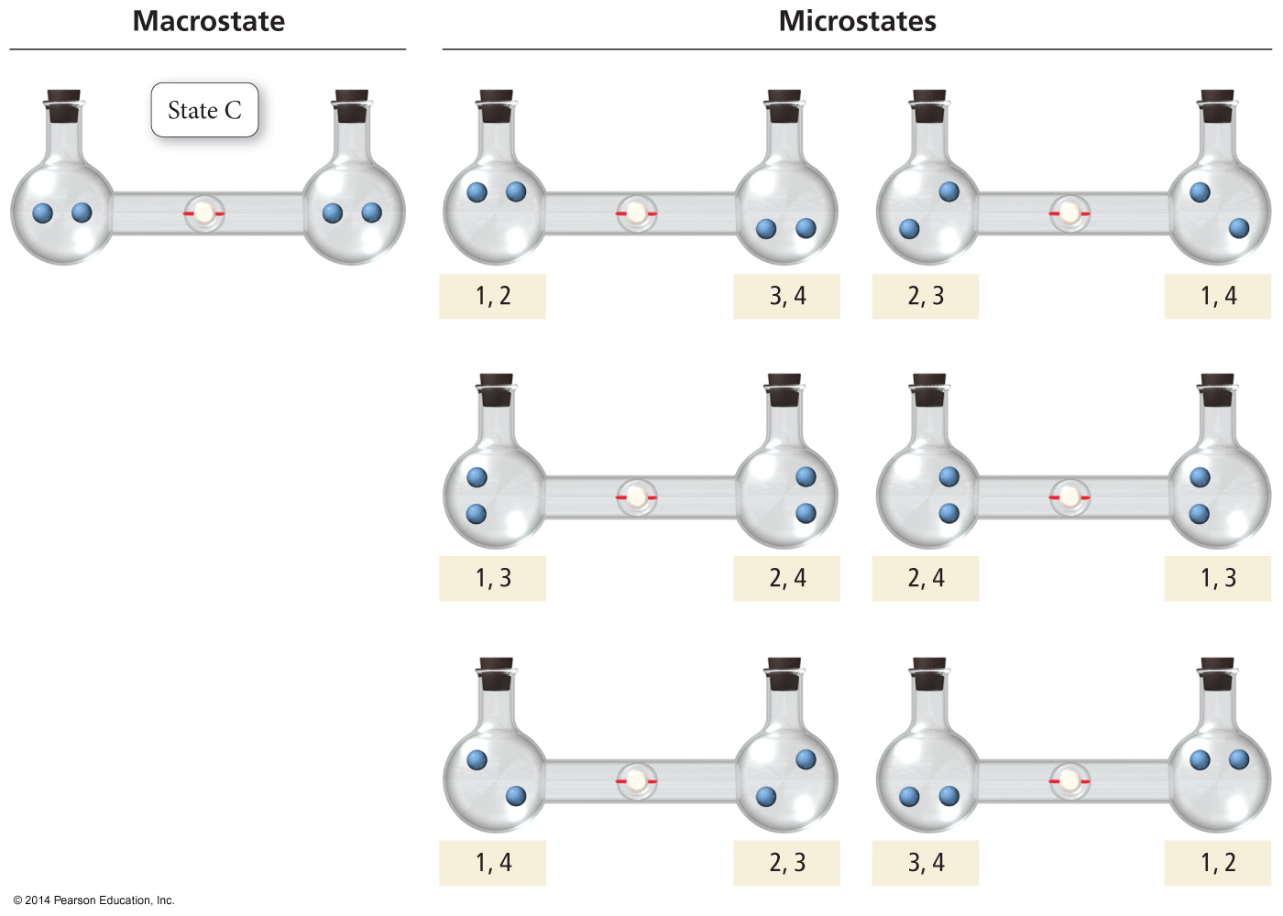
There are six microstate ways to make macrostate C!
Images from “Chemistry: A Molecular Approach”, Tro, 3rd ed

Slide 9
Macrostate C has higher entropy than macrostates A & B because there are more microstates that are equivalent to macrostate C than there are microstates that are equivalent to macrostate A or macrostate B
Images from “Chemistry: A Molecular Approach”, Tro, 3rd ed

Slide 10
What is the “seating chart entropy” of this class?
There are 12 students in this class; if there are 12 (fixed) chairs, what is the total possible number of ways the seating chart could be arranged?
What is the Boltzmann entropy value (S = k ln W) for the possible seating chart arrangements of this class?
What is the Shannon information content (log₂(1/p)), in bits, of any individual seating chart arrangement?

Slide 11
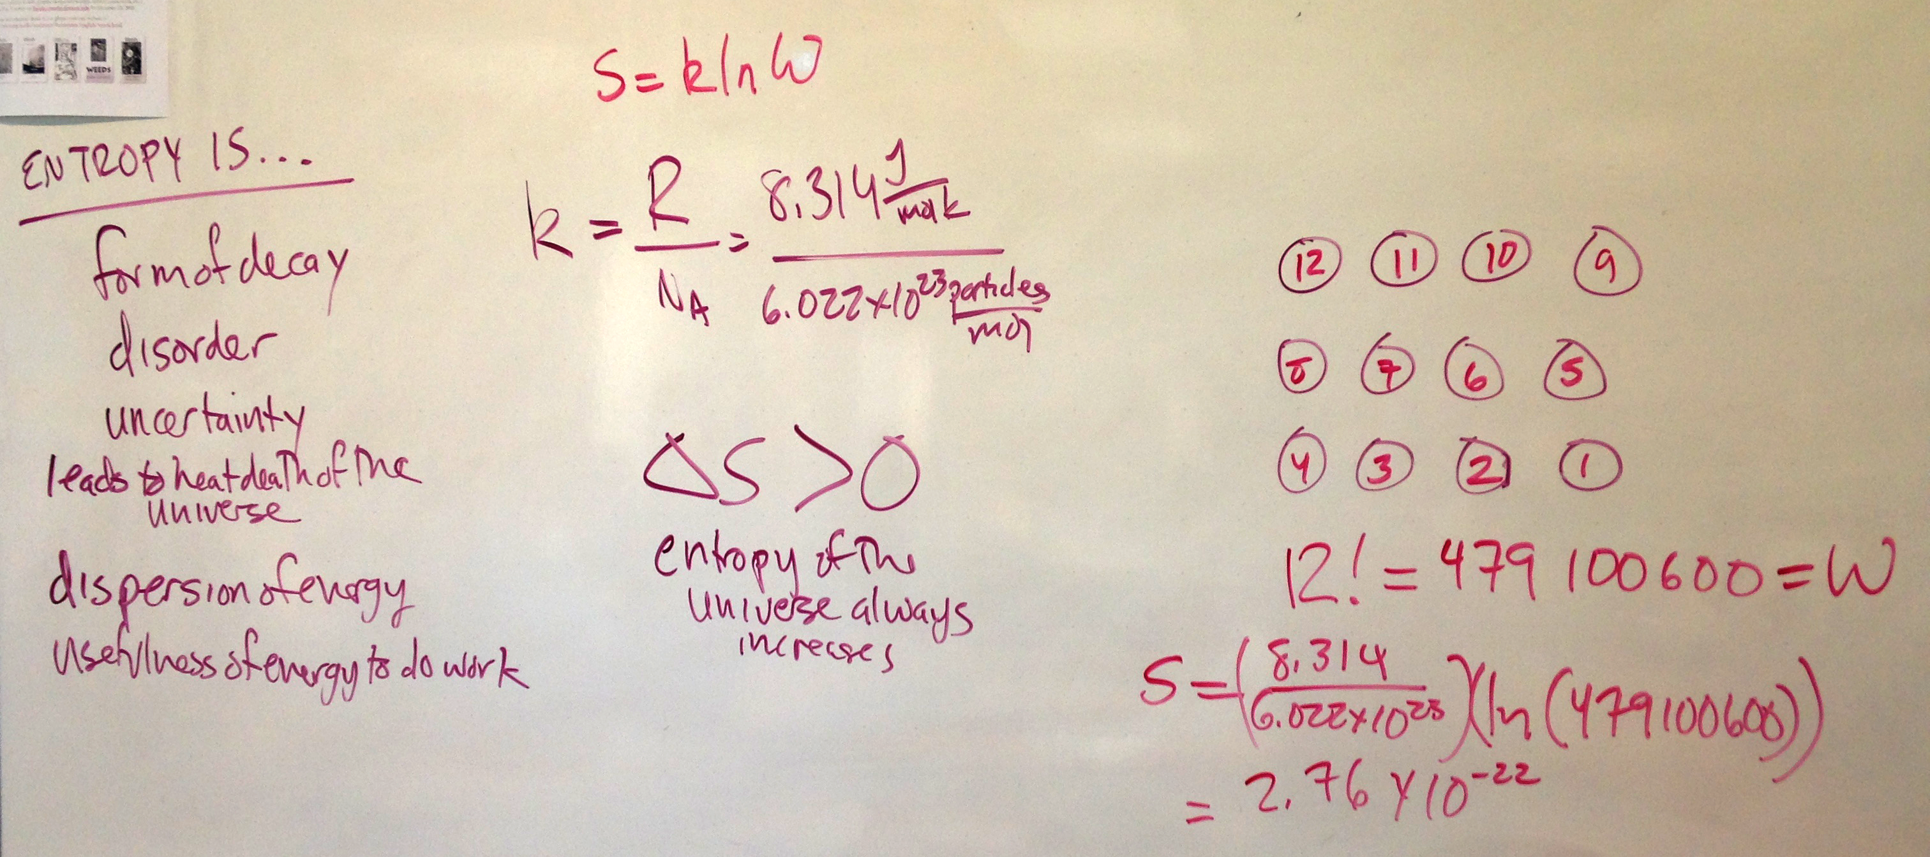

Slide 12
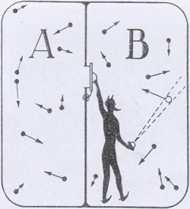
When I sorted the class into a non-habitual, uncommon seating arrangement, I was acting like a Maxwell’s demon. I used information gathered from facial features and manner of dress to decide whether to seat each student on the right side of the classroom or on the left side.
Information is the cost of imposing order on a small portion of the universe, of identifying or selecting one possible configuration out of many
This is a definition of “information” that I came up with based on the documents I studied while preparing for this lecture.
Image from http://www.eoht.info/page/Maxwell's+demon

Slide 13
How does a protein fold into the correct structure?

Slide 14
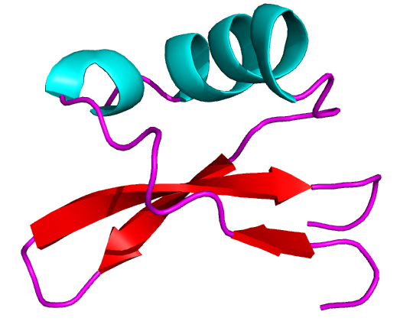
Brazzein
DKCKK VYENY PVSKC QLANQ CNYDC KLDKH
ARSGE CFYDE KRNLQ CICDY CEY
How does a protein get from the linear arrangement of amino acids (represented here by letters) to the complex three-dimensional shape that gives it its function (represented here by a trace drawn through the positions of a specific atom in each amino acid)?
Assadi-Porter, et al. J. Biol. Chem. 2003, 278, 31331–31339

Slide 15
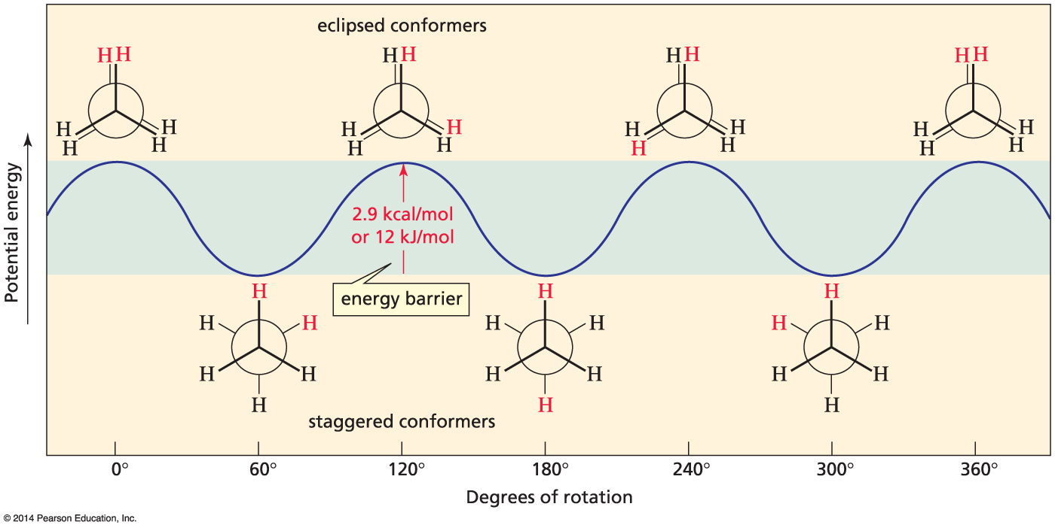
A molecule with two carbon atoms has two major conformations that differ in energy
conformational analysis of ethane
Image from “Organic Chemistry”, Bruice, 8th ed

Slide 16
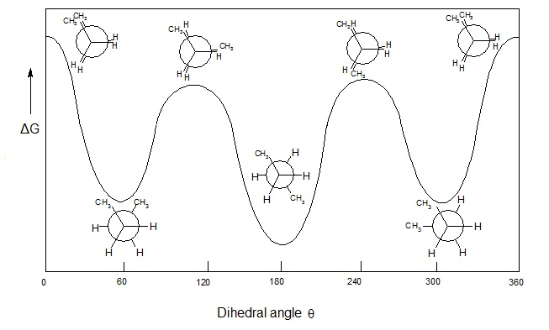
A molecule with four carbon atoms has four major conformations; two of those conformations can be achieved in two different ways. Thus, the four-carbon molecule has greater conformational freedom/entropy than the two-carbon molecule.
The longer the carbon chain gets, the more conformational flexibility it has and the greater the number of conformations with similar energies becomes.
conformational analysis of butane
Image from https://en.wikipedia.org/wiki/Conformational_isomerism

Slide 17
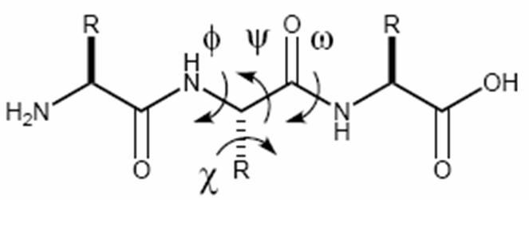
conformational analysis of a peptide/protein chain
The conformations of proteins can be defined by the values of the four dihedral angles marked here. The phi (φ), psi (ψ), and omega (ω) angles define the conformation of the protein backbone, while the chi (χ) angle defines the relationship of the side chain to the backbone.
Image from http://chem3513-2007.pbworks.com/w/page/15648429/Peptidomimetics

Slide 18
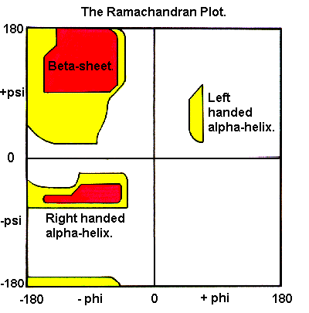
conformational analysis of a peptide/protein chain
glycine increases the conformational freedom of the chain for neighboring amino acids
Just as the entropy of the English language is decreased by the frequency of certain combinations of letters, the conformational entropy of a protein chain is decreased somewhat because the conformations of amino acids in a protein are influenced by the conformations of their neighbors within the sequence of the chain.
Analysis of protein and peptide structures shows that certain combinations of φ and ψ are associated with certain types of secondary structures
proline decreases the conformational freedom of the chain for neighboring amino acids
I double-checked what I’d been telling you about glycine and proline in collagen, and fortunately I was remembering it mostly right — https://en.wikipedia.org/wiki/Collagen
Image from http://swissmodel.expasy.org/course/text/chapter1.htm

Slide 19
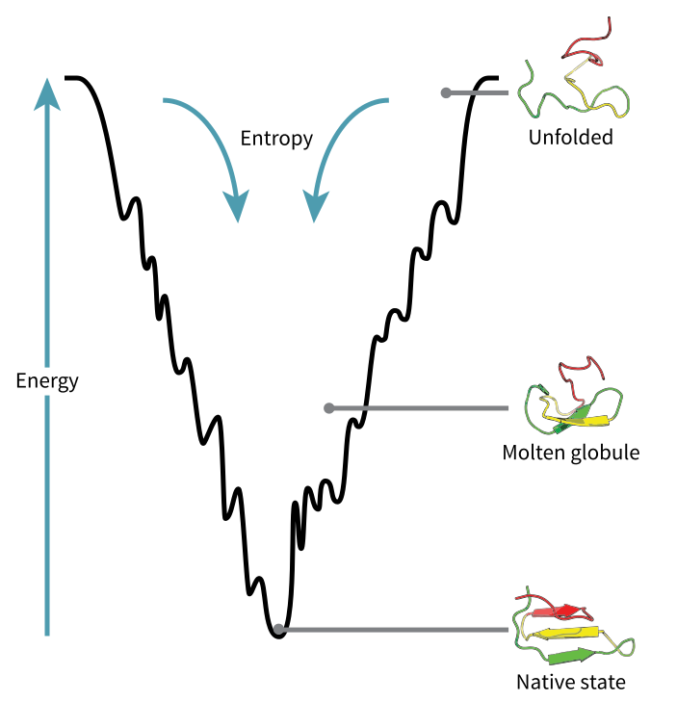
flopping down the funnel of the energy landscape
As an unfolded protein chain flops around — “explores conformational space” in formal jargon — when amino acids or short sequences of amino acids fall into favorable (lower energy) conformations, those conformations persist. Neighboring amino acids are then influenced to adopt similar conformations, causing secondary structure elements to form and extend. Eventually the protein reaches the lowest possible energy, the most stable group of conformations, which is called the “native state”. The width of the base of the energy funnel is indicative of the conformational entropy of the native state, or how many conformational variations the native state has.
Image from https://en.wikipedia.org/wiki/Folding_funnel

Slide 20
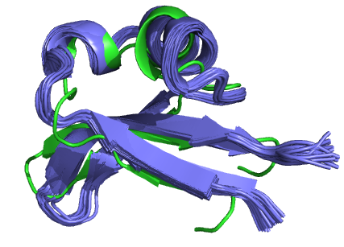
Conformational Entropy: a protein is not a single, static structure but rather a dynamic ensemble of many similar structures
X-ray crystallography usually produces a single structure, a single conformation of the protein “locked in” by the crystallization process. Nuclear Magnetic Resonance (NMR) methods for determining the solution structures of proteins produce an ensemble/bundle of many structures with very similar conformations and very similar energies. Usually the 10, 15, or 20 lowest energy conformations are shown in the bundle.

Slide 21
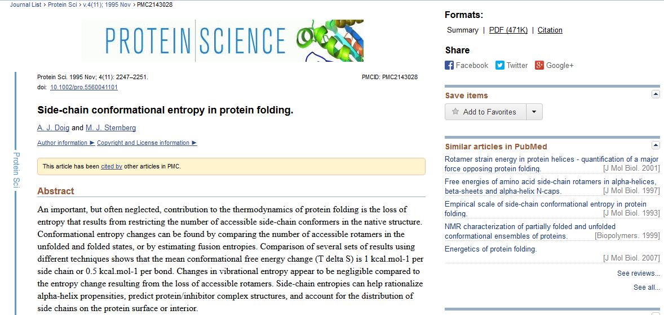
The next several slides are a few examples from the protein structure literature of the sort of information about protein structure and function that can be gained from studying conformational entropy. There’s about 25 years of this stuff out there to study!
http://www.ncbi.nlm.nih.gov/pmc/articles/PMC2143028/

Slide 22
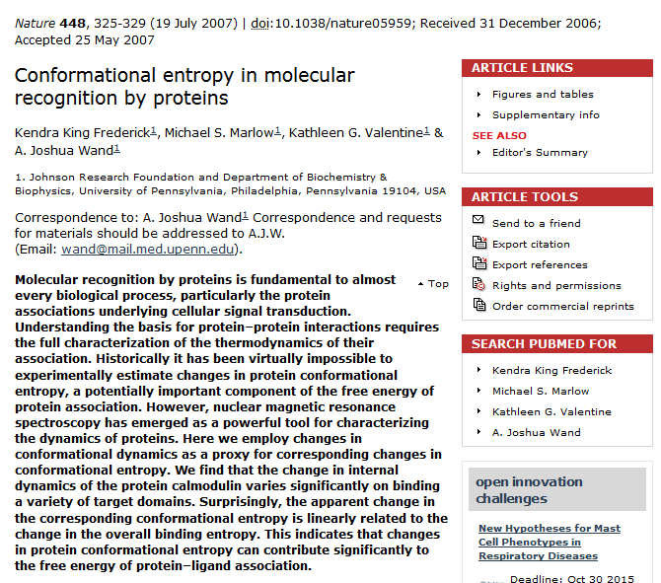
http://www.nature.com/nature/journal/v448/n7151/full/nature05959.html

Slide 23

http://pubs.acs.org/doi/abs/10.1021/ja405200u

Slide 24
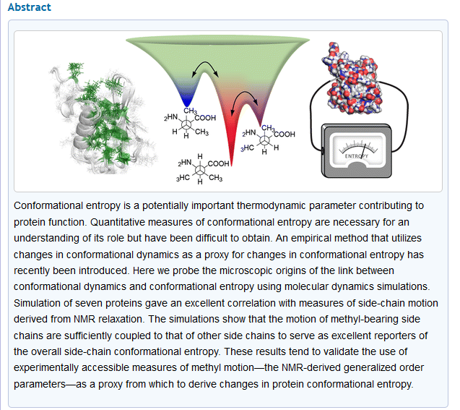
I picked this article for this nice figure that illustrates in the left image both backbone (pale grey) and side chain (green) conformational entropy of the structure of the protein and in the center image the energy differences between different side-chain conformations.
http://pubs.acs.org/doi/abs/10.1021/ja405200u

Slide 25
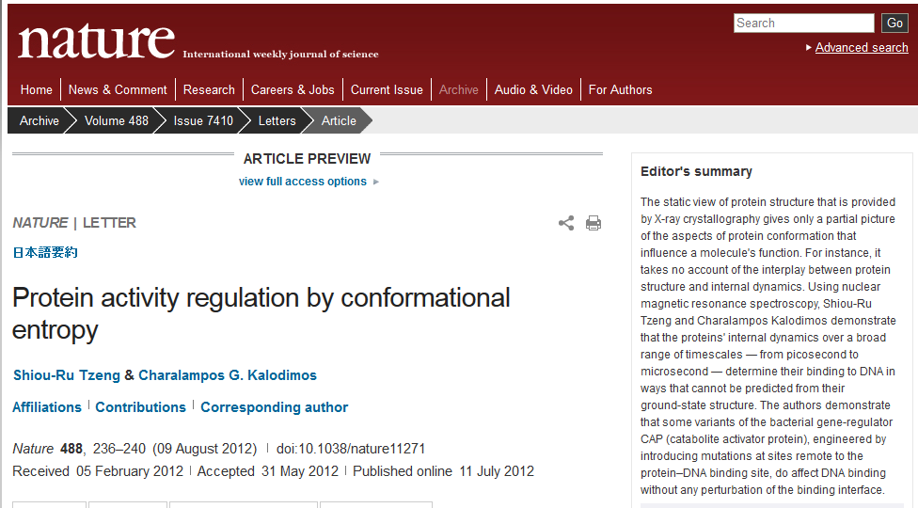
http://www.nature.com/nature/journal/v488/n7410/full/nature11271.html

Slide 26
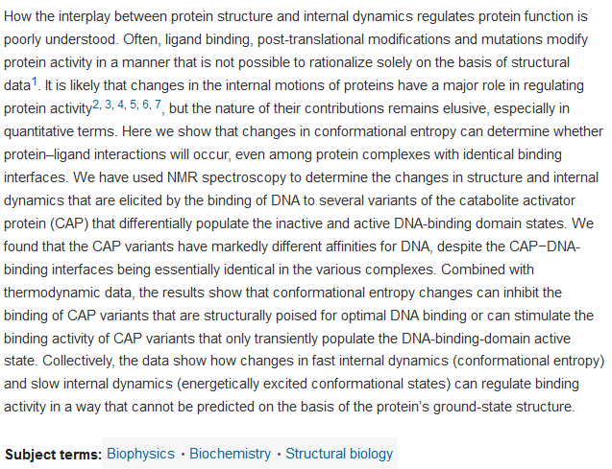
This article illustrates how understanding the conformational entropy of a protein can also help us to understand how the protein functions
http://www.nature.com/nature/journal/v488/n7410/full/nature11271.html

Slide 27
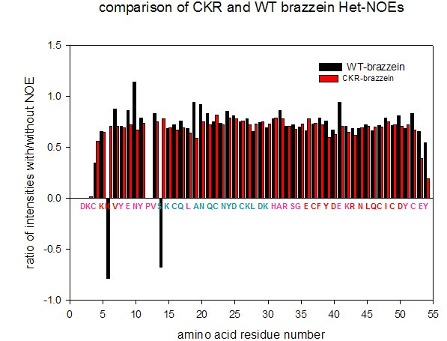
One of the first methods for measuring the internal dynamics of a protein:
the Het-NOE indicates flexibility; more rigid sections of the polypeptide chain will have high values while more flexible sections will have lower values
(Kay, et al. Biochemistry, 1989, 28, 8972-8979)
In my mutant CKR-brazzein, the sequence changes I made strengthened the secondary structure of the termini of the protein. This strengthening of the secondary structure was compensated for by an overall increase in flexibility of the protein.

Slide 28
Conformational Entropy is an example of how information is contained within/can be obtained from the entropy of a system
Studying & understanding conformational entropy allows
• improved de novo prediction of protein structure based on primary sequence
• better understanding of how proteins interact with each other
• insight into ligand binding and enzyme reaction mechanisms
And extracting all this information is not without its cost in increasing the overall entropy of the universe, from the evaporation of the liquid nitrogen and liquid helium required to cool the NMR magnets to the neglected dishes & laundry of the graduate students who actually do all the work…

